Slide 1
DW Indexing

Slide 2
Need For Indexing: Speed
Consider searching your hard disk using the Windows SEARCH command.
  Search goes into directory hierarchies.
  Takes several seconds, and there are only a few thousand files.
Assume a fast processor and (even more importantly) a fast hard disk.
  Assume file size to be 5 KB.
  Assume hard disk scan rate of a million files per second.
  Resulting in scan rate of 5 GB per second.

Slide 3
Need For Indexing: Speed
Largest search engine indexes more than 8 billion pages
  At above scan rate 1,600 seconds required to scan ALL pages.
  This is just for one user!
  No one is going to wait for 26 minutes, not even 26 seconds.
  If the pages are 400 billion
Hence, a sequential scan is simply not feasible.

Slide 4
Need For Indexing: Query Complexity
How many customers do I have in Karachi?
How many customers in Karachi made calls during April?
How many customers in Karachi made calls to Multan during April?
How many customers in Karachi made calls to Multan during April using a particular calling package?
Notes:
As the complexity of the queries increases, involve table joins, requires aggregates the processing time also increases correspondingly. So the problem is one of knowledge and time.

Slide 5
Need For Indexing: I/O Bottleneck
Throwing hardware just speeds up the CPU intensive tasks.
The problem is of I/O, which does not scale up easily.
Putting the entire table in RAM is very expensive.
Therefore, index!

Slide 6
Indexing Concept: Library Analogy
With the library analogy, the time complexity to find a book? The average time taken
Using a card catalog organized in many different ways i.e. author, topic, title etc and is sorted.
A little bit of extra time to first check the catalog, but it “gives” a pointer to the shelf and the row where book is located.
The catalog has no data about the book, just an efficient way of searching.

Slide 7
Indexing Concept
Purely physical concept, nothing to do with logical model.
Invisible to the end user (programmer), optimizer chooses it, effects only the speed, not the answer.
We do not consider the best and worst case
  We talk about average time

Slide 8
Indexing Goal
Look at as few blocks as possible to find the matching record(s)
Notes:
The point of using an index is to increase the speed and efficiency of searches of the database. Without some sort of index, a user’s query must sequentially scan the database, finding the records matching the parameters in the WHERE clause.

Slide 9
Conventional indexing Techniques
Dense vs. Sparse
Multi-level (or B-Tree) vs. Hash based indexing
Primary Index vs. Secondary Indexes

Slide 10
Dense vs. Sparse

Slide 11
Dense Index: Concept
Dense Index
File
Every key in the data file is represented in the index file
10
10
20
20
30
30
40
40
50
60
50
70
60
80
70
90
80
100
90
110
100
120

Slide 12
Dense Index: Adv & Dis Adv
Advantage:
  A dense index, if fits in the memory, is very efficient in locating a record given a key
Disadvantage:
  A dense index, if too big and doesn’t fit into the memory, will be expensive when used to find a record given its key

Slide 13
Sparse Index: Concept
Sparse Index
Tuple
10
10
Normally keeps only one key per data block
Some keys in the data file will not have an entry in the index file
20
30
50
30
70
40
90
110
50
130
60
150
70
170
80
190
90
210
100
230

Slide 14
Sparse Index: Adv & Dis Adv
Advantage:
  A sparse index uses less space at the expense of somewhat more time to find a record given its key
  Support multi-level indexing structure
Disadvantage:
  Locating a record given a key has different performance for different key values

Slide 15
Sparse Index: Multi level
Sparse 2nd level
File
10
10
10
90
30
20
170
50
30
250
70
40
90
330
50
110
410
60
130
490
150
570
70
170
80
190
90
210
100
230

Slide 16
B-tree vs. Hash

Slide 17
B-tree Indexing: Concept
Can be seen as a general form of multi-level indexes.
Generalize usual (binary) search trees (BST).
Allow efficient and fast exploration at the expense of using slightly more space.
Popular variant: B⁺-tree
Support more efficiently queries like:
SELECT * FROM R WHERE 0<= b and b<42

Slide 18
B-tree Indexing: Example
Looking for Empno 250
200
220
250
280
130
9
20
100
200
210
215
250
256
279
140
145
220
230
280
300
RID list
Each node stored in one disk block

Slide 19
B-tree Indexing: Limitations
If a table is large and there are fewer unique values.
Outcome varies with inter-character spaces.
A noun spelled differently will result in different results.
Insertion can be very expensive.

Slide 20
B-tree Indexing: Limitations Example
Given that MOHAMMED is the most common first name in Pakistan, a 5-million row Customers table would produce many screens of matching rows for MOHAMMED AHMAD, yet would skip potential matching values such as the following:
VALUE MISSED | REASON MISSED
Mohammed Ahmad | Case sensitive
MOHAMMED AHMED | AHMED versus AHMAD
MOHAMMED AHMAD | Extra space between names
MOHAMMED AHMAD DR | DR after AHMAD
MOHAMMAD AHMAD | Alternative spelling of MOHAMMAD

Slide 21
Hash based indexing
DWH-Ahsan Abdullah

Slide 22
Hash Based Indexing: Concept
In contrast to B-tree indexing, hash based indexes do not (typically) keep index values in sorted order.
Index entry is found by hashing on index value requiring exact match.
SELECT * FROM Customers WHERE AccttNo= 110240
Index entries kept in hash organized tables rather than B-tree structures.
Index entry contains ROWID values for each row corresponding to the index value.

Slide 23
Hashing as Primary Index
.
.
key → h(key)
records
disk block
.
.
.
Note on terminology:
The word "indexing" is often used synonymously with "B-tree indexing".

Slide 24
Hashing as Secondary Index
key
record
key → h(key)
Index
Can always be transformed to a secondary index using indirection, as above.
Indexing the Index

Slide 25
B-tree vs. Hash Indexes
Indexing (using B-trees) good for range searches, e.g.:
SELECT * FROM R WHERE A > 5
Hashing good for match based searches, e.g.:
SELECT * FROM R WHERE A = 5

Slide 26
Primary Key vs. Primary Index
Relation Students
Name ID dept
AHMAD 123 CS
Akram 567 EE
Numan 999 CS

Slide 27
Primary Key vs. Primary Index
Relation Students
Name ID dept
AHMAD 123 CS
Akram 567 EE
Numan 999 CS
Primary Key & Primary Index:
  PK is ALWAYS unique.
  PI can be unique, but does not have to be.
In DSS environment, very few queries are PK based.

Slide 28
Primary Indexing: Criterion
Primary index selection criteria:
  Common join and retrieval key.
  Can be unique UPI or non-unique NUPI.
  Limits on NUPI.
  Only one primary index per table (for hash-based file system).

Slide 29
Primary Indexing Criteria: Example
Call Table
call_id | decimal (15,0) NOT NULL
caller_no | decimal (10,0) NOT NULL
call_duration | decimal (15,2) NOT NULL
call_dt | date NOT NULL
called_no | decimal (15,0) NOT NULL
What should be the primary index of the call table for a large telecom company?
No simple answer!!

Slide 30
Primary Indexing
Almost all joins and retrievals will occur through the caller _no foreign key.
  Use caller_no as a NUPI.
In case of non uniform distribution on caller_no or
if phone number have very large number of outgoing calls (e.g., an institutional number could easily have several thousand calls).
  Use call_id as UPI for good data distribution.

Slide 31
Primary Indexing
For a hash-based file system, primary index is free!
  No storage cost.
  No index build required.
OLTP databases use a page-based file system and therefore do not deliver this performance advantage.

Slide 32
Special Index Structures
  Inverted index
  Bit map index
  Cluster index

Slide 33
Inverted index: Concept

Slide 34
Inverted Index: Example-1
D1: M. Aslam BS Computer Science Lahore Campus
D2: Sana Aslam of Lahore MS Computer Engineering with GPA 3.4 Karachi Campus
Inverted index for the documents D1 and D2 is as follows:
3.4 → [D2]
Asalm → [D1, D2]
BS → [D1]
Campus → [D1, D2]
Computer → [D1, D2]
Engineering → [D2]
GPA → [D2]
Karachi → [D2]
Lahore → [D1, D2]
M. → [D1]
MS → [D2]
of → [D2]
Sana → [D2]
Science → [D1]
with → [D2]
Notes:
Add material on notes

Slide 35
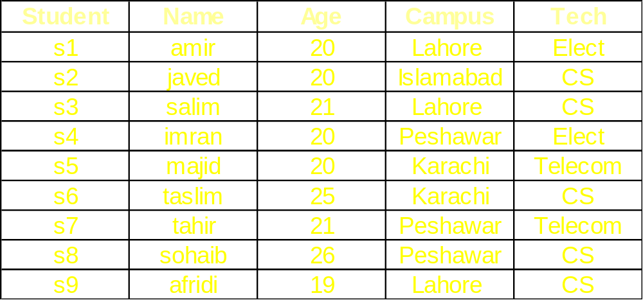
Subset table
…

Slide 36
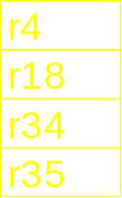

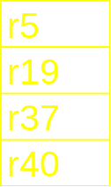
Inverted Index: Example-2
. . .
B-tree
Index
r500
afridi
19
CS
data
records
inverted
index
Notes:
Add material on notes

Slide 37
Inverted Index: Query
Query:
  Get students with age = 20 and tech = “telecom”
List for age = 20: r4, r18, r34, r35
List for tech = “telecom”: r5, r35
Answer is intersection: r35

Slide 38
Bitmap Indexes: Concept

Slide 39
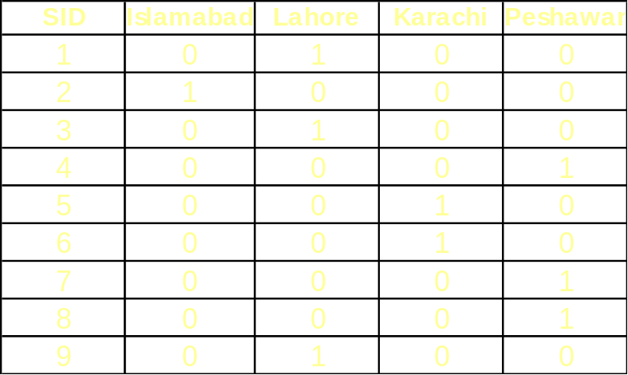
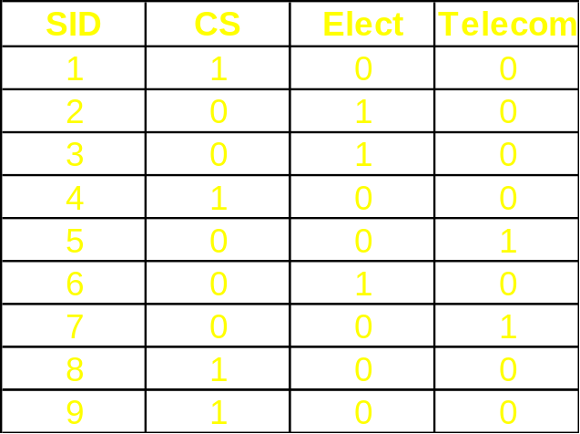
Bitmap Indexes: Example
The index consists of bitmaps, with a column for each unique value:
Index on City (larger table):
Index on Tech (smaller table):

Slide 40
Bitmap Index: Query
Query:
  Get students with age = 20 and campus = “Lahore”
List for age = 20: 1101100000
List for campus = “Lahore”: 1010000001
Answer is AND : 1000000000
Good if domain cardinality is small
Bit vectors can be compressed
  Run length encoding

Slide 41
Bitmap Index: Compression
Basic Concept
1111000011110000001111100000011111 INPUT
14#04#14#06#15#06#15 OUTPUT
1010101010101010101010101010101010 INPUT
11#01#11#01#11#01#11#01#… OUTPUT
11111111111111110000000000000000 INPUT
117#017 OUTPUT
Case-1
Case-2
Case-3

Slide 42
Bitmap Index: More Queries
  “Which students from Lahore are enrolled in ‘CS’?”
  “How many students are enrolled in ‘CS’?”

Slide 43
Cluster Index: Concept

Slide 44
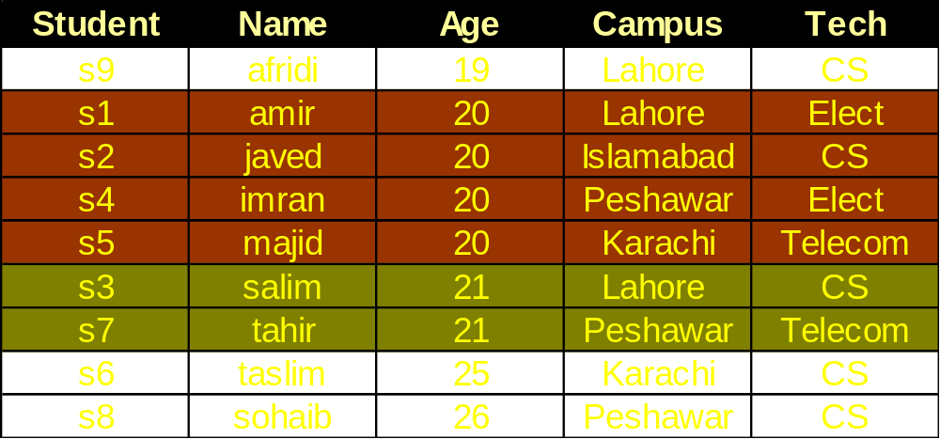
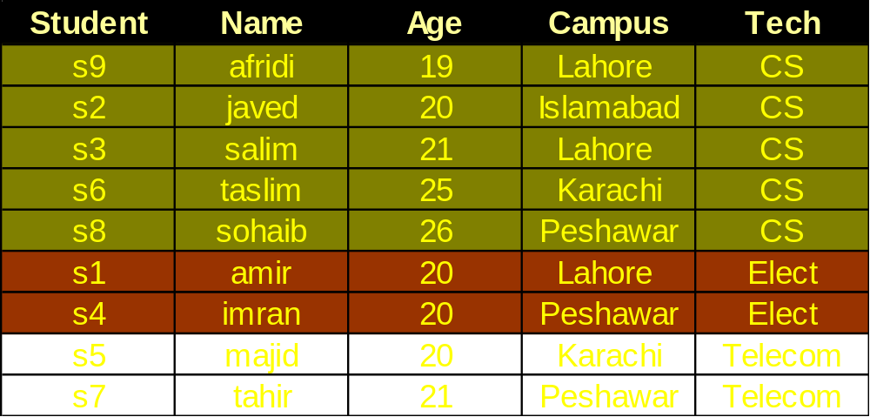
Cluster Index: Example
Cluster indexing on AGE
One indexing column at a time
Cluster indexing on TECH

Slide 45
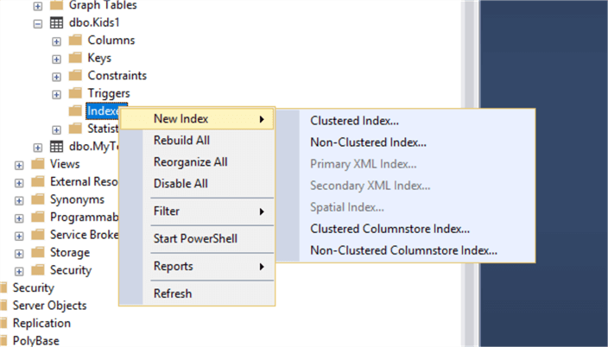
DWH-Ahsan Abdullah

Slide 46
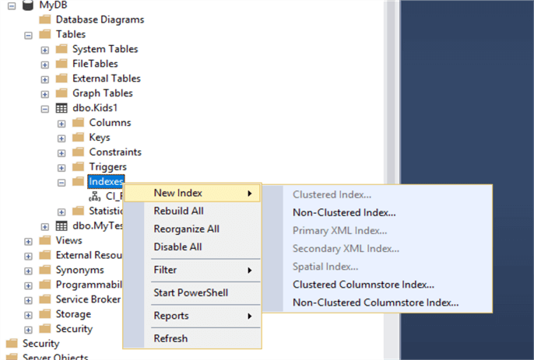
DWH-Ahsan Abdullah

